Slide 1
April 10, 2023
Patrick Behne, PhD
Transient Multiphysics Simulation of Spent Fuel Repositories for Pebble-bed Reactors
April 2023 Update

Slide 2
Progress
Learning MOOSE:
Navier-Stokes module
Natural convection loop
Multiapp system
PatternedMeshGenerator bug
Interface condition development
Large 3D simulations
MPI issues on Sawtooth

Slide 3
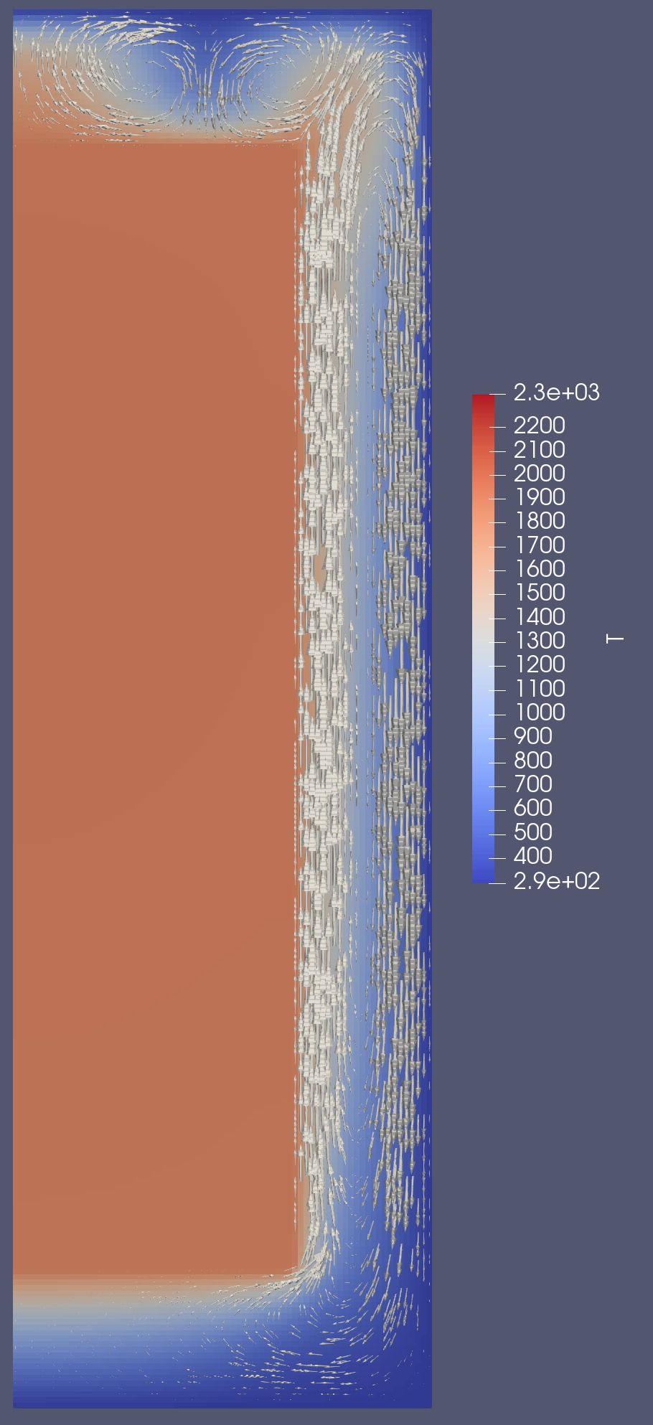
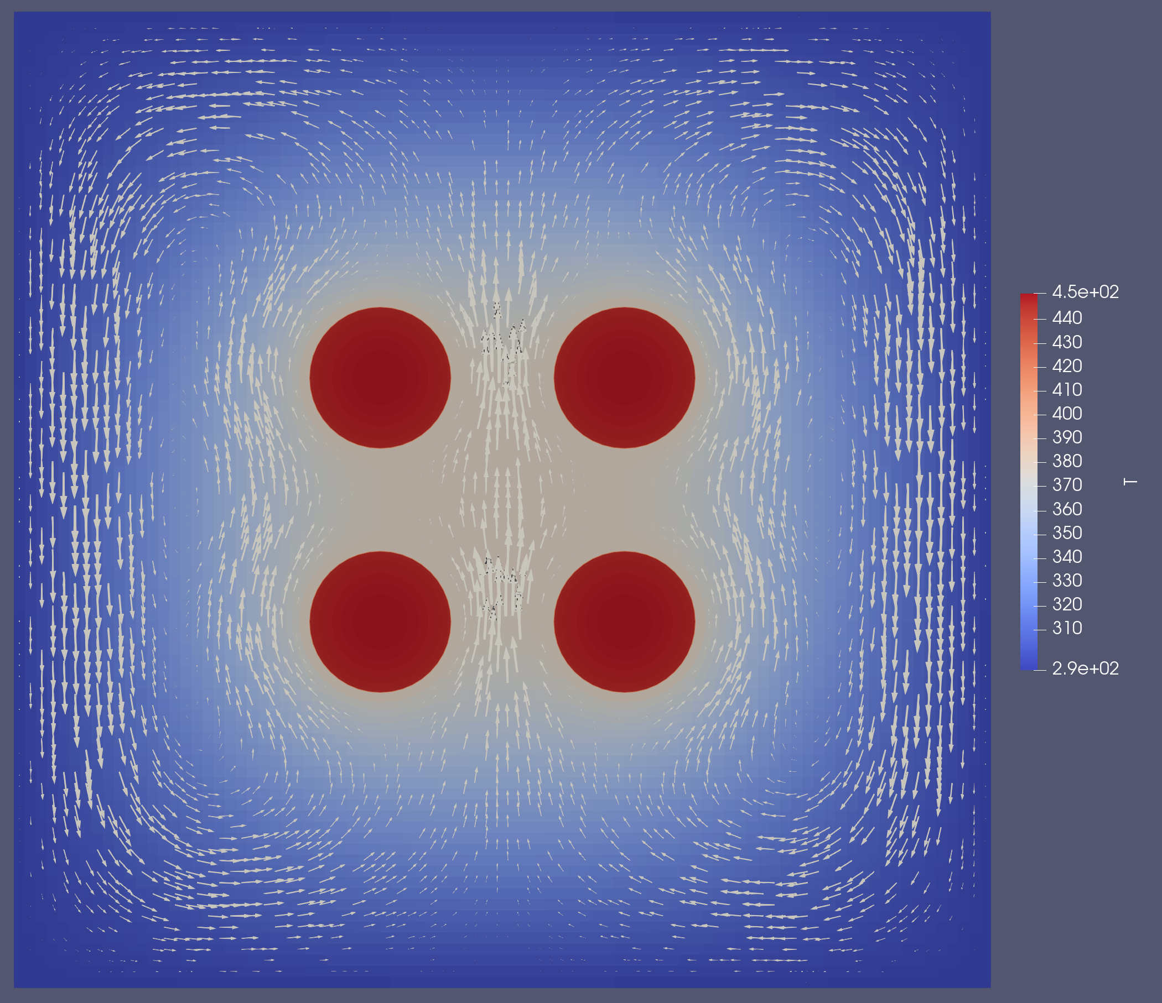
Results
2D Convection Loop w/ Multiapps
2D RZ Convection Loop

Slide 4
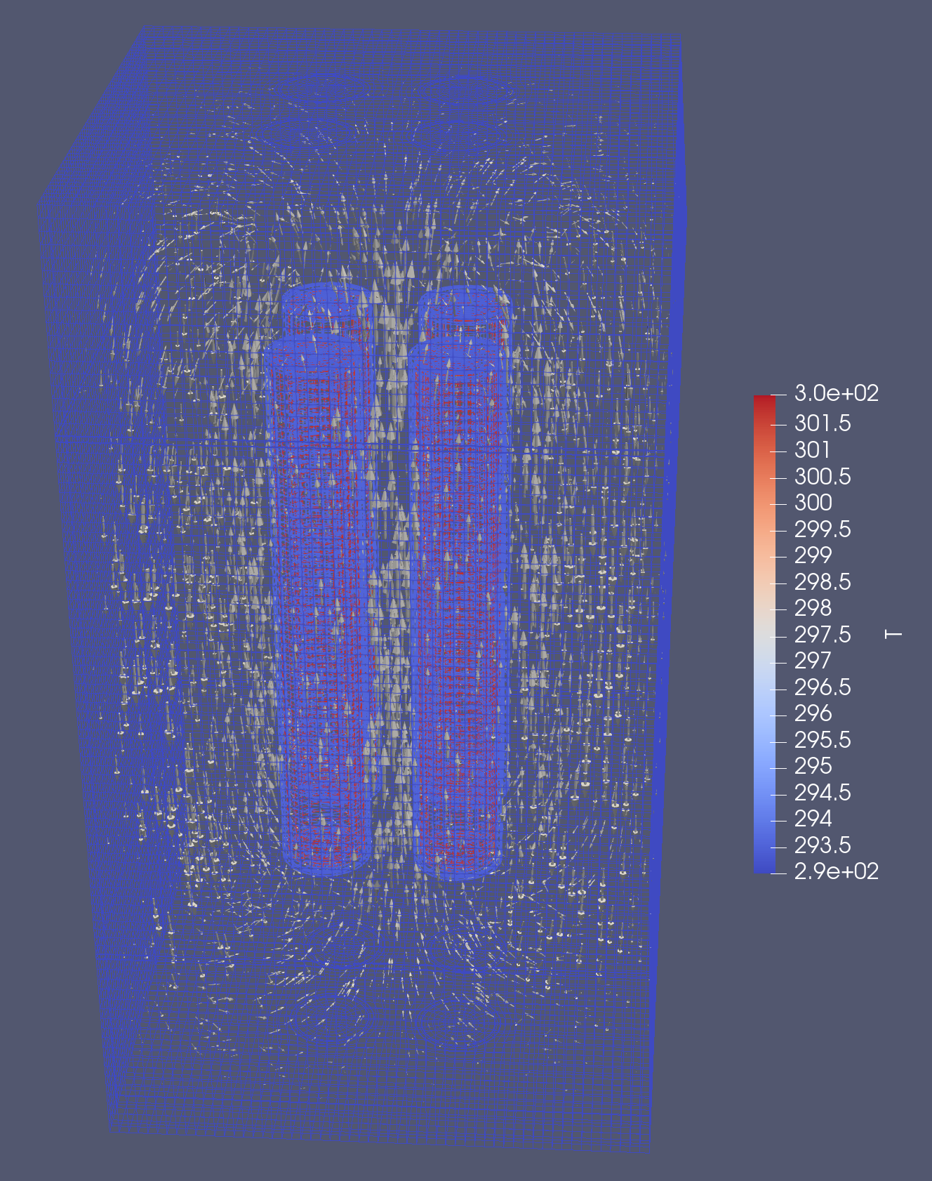
Results
3D Convection Loop w/ Multiapps

Slide 5
Next Steps
Make flow porous
Learn BISON models for pebbles for embedding multiscale fuel models
Learn OpenMC for XS generation
Generate cask source term (need gPBR model from Paolo)
Generate cask for real mesh

